Slide 1
AD CODING COMPETITION 2012
28 June 2012
AIDAN & PAVAN

Slide 2




It’s all about….

Slide 3


Getting Started..
https://github.com/ptpavankumar/Competition
https://www.yammer.com/myob.com/groups/adcodingcompetition

Slide 4
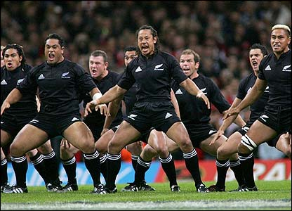
The challenge

Slide 5




The tools…

